Slide 1
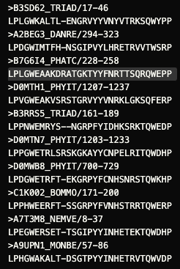
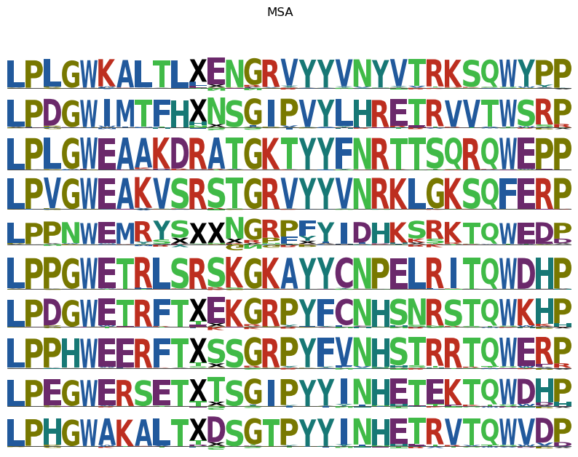
21 CHANNELS, BATCH_SIZE=10, LENGTHSCALE = 0.5, ITERS = 500

Slide 2
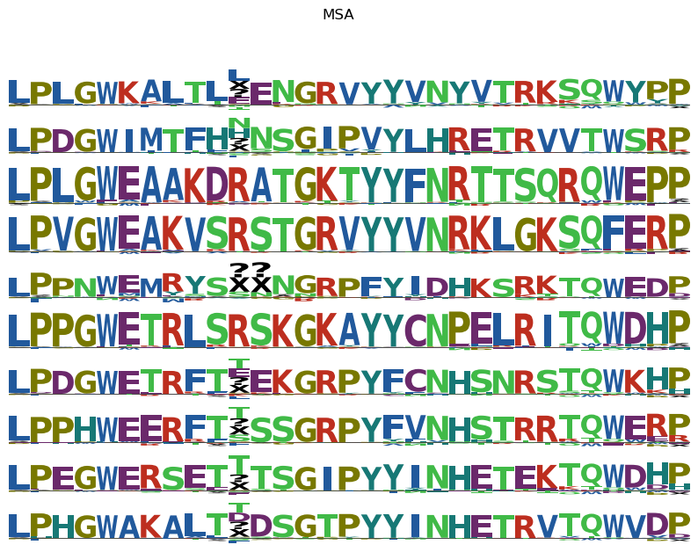
22 CHANNELS, BATCH_SIZE=4, LENGTHSCALE = 0.65, ITER = 140,

Slide 3
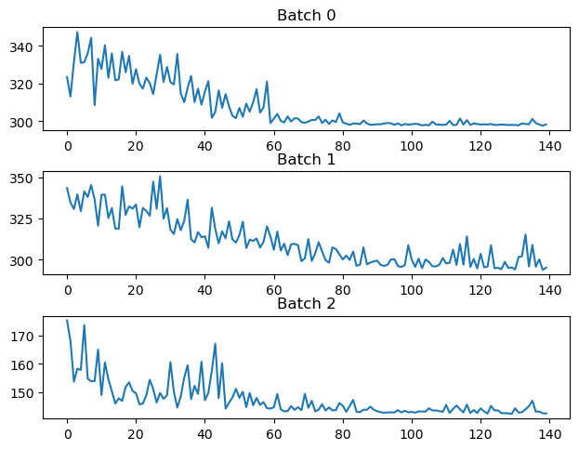
22 CHANNELS, BATCH_SIZE=5, LENGTHSCALE = 0.5, ITER = 160,

